Slide 1
Stellar Fashion Limited
Company Profile

Slide 3
Stellar Fashion Limited
Primarily dealing in apparel industry as a Sourcing Partner/Agent in Bangladesh based in Dhaka. Stellar Sourcing highly equipped with a group of high skilled people worked in factory, multinational company in apparel sector. Our presence in around the globe and very strong presence in north America. Working for renowned retail brands and importers. We are always connected with our customers, our production partners and people. We have chosen them or they have found us because we share our values and vision.
Stellar Sourcing was established in 2020 with a object to support the readymade garments industry in Bangladesh.
Stellar Sourcing is working for all product categories and very strong in denim apparels. To achieve the highest satisfaction of our customers, we are very sensitive and selective to choose our production partner and established our supply chain.

Slide 4
At a Glance – Stellar Sourcing
Established In 2020
Customers : Hope & Henry LLC, FAM Brands (Costco & BJ’S), Goop.
Brands :
Market : North America
Local Brands : Lereve, Virgo, Rise, Artisan
Product :
Cut & Sewn Knits : T-Shirt, Polo, Tank Top, Dresses, Hoodie, Jogger, Leggings, Lingerie, PJ Set.
Sweater : Pullover, Cardigan, Vest, Dresses, Jacket, Accessories,
Woven : All types of Shirts, blouses, Tops, Denim/Non Denim Bottoms, Outerwear etc.

Slide 5
Vision
Philosophy
Passion for a business that is challenging and that pushes our limits every day. Sometimes our desks are altars on which we sacrifice not only our time, but ourselves. But we love it. We wouldn't have it any other way.
To be a Professional & Creative Global fashion Company that cares
The industry is clear. There is little difference between the good sourcing agencies in terms of merchandising and quality. These are the minimum requirements.
We add human value to our service at every level. We care about our people, about our customers, and about our production partners.
Mission
Understanding and fulfilling customers` and markets dynamic needs. Developing and maintaining mutual relationships with our suppliers. Constantly developing the potential of our human resources.

Slide 6
Culture we practice
Best work space Family & Friendly Environment
Personal & Professional Growth
Learning / Training and Grooming Development
WE ARE HUMBLE IN OUR APPROACH AND CONVINCED OF OUR DIRECTION, BUT WE ARE PROUD OF OUR ACHIEVEMENT AND OPEN MINDED FOR POSIBILITIES
WE ARE HUMANE IN OUR DEALINGS AND DEMANDING ON PERFORMANCE ALSO, BUT WE ARE DEMANDING IN OUR EXPECTATIONS AND APPRECIATING EFFORTS AS WELL.
WE ARE FOCUSED ON OUR WORK, BUT WE CARE FOR OUR SOCIAL, PHYSICAL, MENTAL AND SPIRITUAL NEEDS

Slide 7
Our Services:
Working as buying agents /local representative to execute the orders on behalf of the customer/buyers.
Sourcing Cost effective and Quality Apparel Items with specialized from leading class and compliant Factories
Bulk Production follow up, inline inspections, final inspections by our qualified & experienced Quality Auditors/quality Assurance Inspectors.
Monitoring and assuring on time delivery/shipment of the garments for the customers

Slide 8
Our Product - Woven

Slide 9
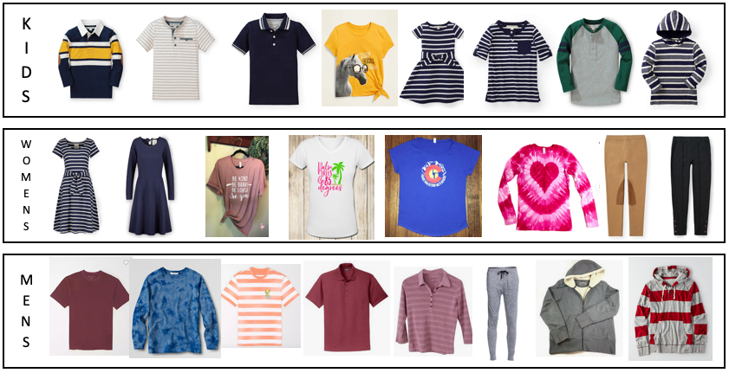
Our Product - Knit

Slide 10
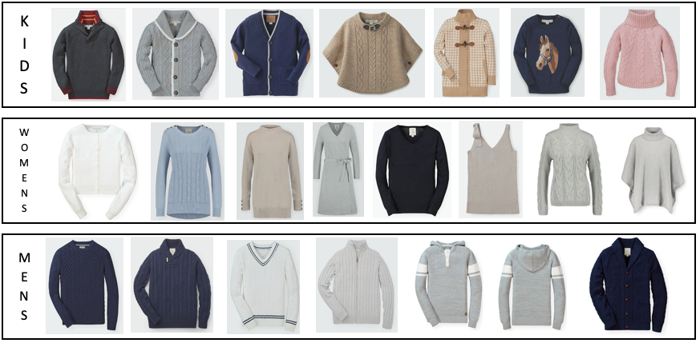
Our Product - Sweater

Slide 11
Our Associated Factories
SQUARE DENIM LIMITED
AKH Group – AKH Eco Apparels Ltd.
Sonia Group
Sonia & Sweaters Ltd.
Sonia Fine Knit Ltd.
Naba Knit Composite Ltd.
Smart Group
Smart Jacket Ltd.
Apparel Promoters Ltd.
Knit Plus Ltd.
Rapid Design Ltd.
Ocean Sweater Ind (Pvt) Ltd.
Panwin Design Ltd.
JK Group
DBL Group

Slide 12
Our Organogram
Chairman
Managing Director
Kinit & Sweater Division
Development & Costing
Director
Technical Division
Tech-Design
Executive Director
Woven Division
Production / WIP Follow-up
Development & Costing
Production & WIP Follow-up
Quality Assurance
HR, Admin
Accounts & Banking
Merchandising Team
Merchandising Team
Merchandising Team
Merchandising Team
Team
Team
Team
Team
Director
HR, Admin & Accounts

Slide 13
Stay in touch with Us
Office Address:
House No. 27, Road No. 15
Rupnagar Residential Area, Mirpur
Dhaka-1216, Bangladesh
Contact Person:
Md. Wazed Ali Chowdhury
Mobile: +8801755535992
Email: wazed@stellarfashion.net

